Slide 1
Stop exporting your SmartLists to Excel! Create Excel Refreshable Reports instead!
San Antonio, Texas
October 13-17, 2024

Slide 2
John Arnold
Senior Software Engineer for US Digital – Vancouver, WA Geek/nerd for many years (decades) who still loves all forms of programming (C#, SQL...) Dedicated family man who loves his family, woodworking, Lego, puzzles, and Mtn Dew Born and raised in Pittsburgh but now
calls the PNW home
Slide Deck Version 1.0

Slide 3
Session Agenda
What is an Excel Refreshable Report
Connection Properties
GP and Office Data Connection (ODC) files
Stored Procedures vs Views
Refreshable Report Template
Security, Active Directory, and SQL

Slide 4
Saving a SmartList to Excel
Open a SmartList
Wait for it to refresh
Remember to reset the record count
Wait for it to refresh
Set columns and filters
Wait for it to refresh
Export it to Excel
Wait for it to refresh

Slide 5
Issues with Saving a SmartList
Data can be changed
Number of decimals can be changed
Dex.ini settings can change how things are exported
It can be slow
The data is static and can't be refreshed

Slide 6
What is an Excel Refreshable Report
An Excel Table
Connection to a Database
Read only view of Data
Easily refreshed
Can be a GP supplied report or user created
Can be run independently of GP

Slide 8
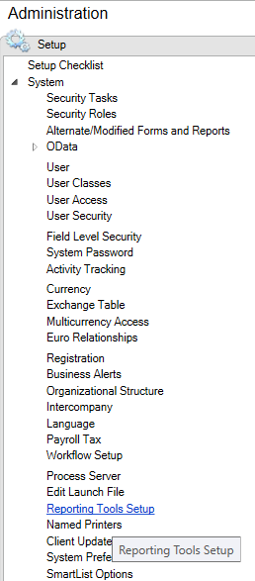
Installing GP Reports
Administration -> System
Reporting Tools Setup

Slide 9
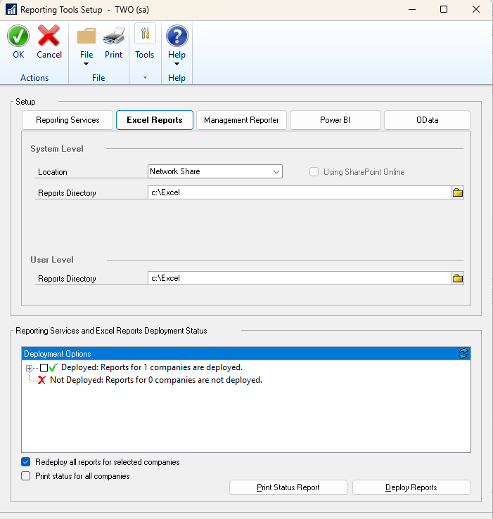
Installing GP Reports
Specify Report Directory
This is usually a shared
folder on the network
Press the "Deploy Reports" button

Slide 10
Connection Properties
Specify how and when the query should run
Data Tab -> Queries & Connections
Right click on Connection and select Properties
Usage and Definition Tabs

Slide 11
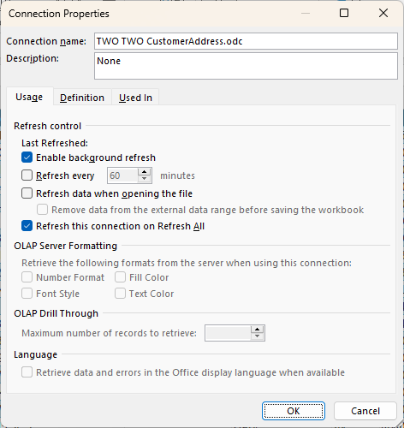
Usage – Connection Properties
Enable background refresh
Allows you to use Excel while the query is running.
Wait for Excel to run the query before you try to do anything.
Turn this off.
Refresh when opening
Turn on – people get used to seeing "live" data.
Remove data when saving
Great for sensitive data.
Refresh on Refresh All
I usually turn this on when there is only one or two connections in a workbook.
I have one workbook with 21 connections where this is turned off.
Refresh every
Excel will refresh the data every n minutes.
I have not found a use case for this yet.

Slide 12
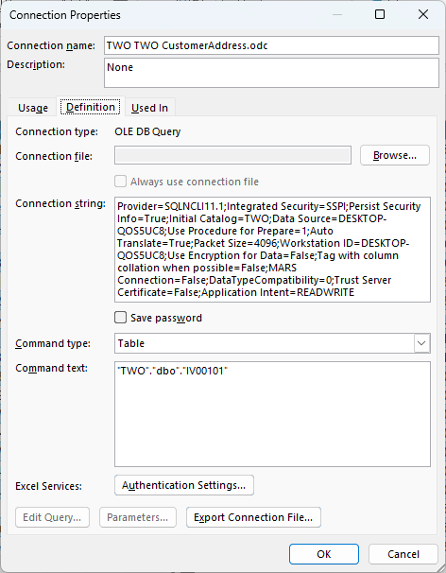
Definition – Connection Properties
Connection name
This is the name of the connection shown in the Queries & Connections list
Name it to match your query
Command Type
SQL – a query is entered in the Command Text
Table – a table/view name is entered in the Command Text
Command Text
The table, view, or SQL code to execute to obtain the data
Connection String
Data Source - the name of the SQL that contains the data
Initial Catalog – the database that contains the data
Recommended – Create DNS alias of GP for the Data Source

Slide 13
Stored Procedures vs View
View – a virtual table that can look like a table to whatever is using it.
Stored Procedure – a piece of code that is executed and can return results. It can also take parameters to filter the data.
This is an extremely simplified explanation!

Slide 14
Views
GP uses Views for all SmartList and Excel Refreshable Reports
They can be a great reference to see how tables should be joined in GP
They can make SQL do a lot more work. Most views join to many tables and the data returned is not even used

Slide 15
Stored Procedures
May contain a single of code (like a View) or many lines (variables, if statements, cursors, temporary tables…) for more complicated queries
Stored Procedure can take parameters to make filtering happen at the database level
Decouples the logic of obtaining the data from displaying the data

Slide 16
Excel Refreshable Report Example
Create a report of invoices
Only include posted invoices
Only include data from the past year
Show the Document Date, Customer Number, Customer Name, SOP Number, Item Number, Item Description, Quantity, and Extended Price

Slide 17
Create with GP Excel Report
Open SalesLineItems.odc
Edit Query Properties
Change Command type to SQL
Edit Command Text to:
Include necessary columns
Filter data as required

Slide 18
Create with GP Excel Report
SELECT [Document Date],
[Customer Number],
[Customer Name],
[SOP Number],
[Item Number],
[Item Description],
QTY,
[Extended Price]
FROM SalesLineItems
WHERE [Document Status] = 'Posted'
AND [Sop Type] = 'Invoice'
AND [Document Date] BETWEEN DATEADD(yy, -1, GETDATE()) AND GETDATE()

Slide 19
Pro and Cons of SalesLineItems
Pro
It's "easy”
Cons
The SalesLineItems view is over 1,460 lines long
78 FROM and 10 JOIN statements
UNION of SOP10200 and SOP20300 - only SOP20300 is needed
Converts SOPTYPE of 3 to 'Invoice' and then checks for 'Invoice'
83 columns are returned
209 functions are called

Slide 20
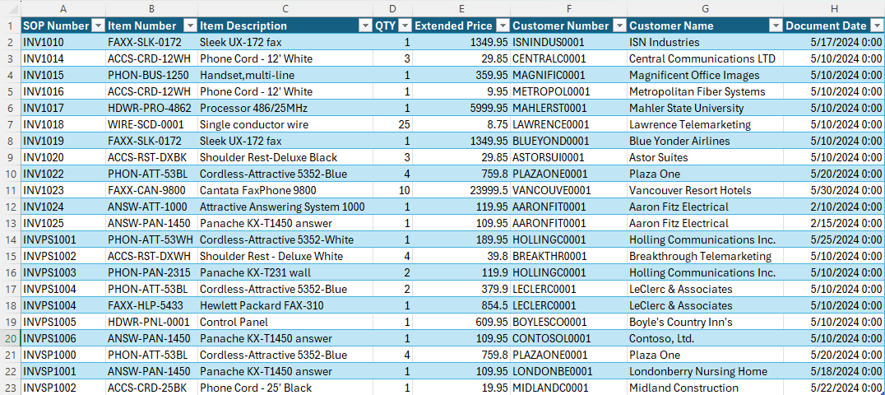
Excel results with new query

Slide 21
John's Report with a Stored Procedure
Create a stored procedure using SSMS
Don’t forget to RTRIM character fields
Download RefreshableReportTemplate.xlsx
Configure the four Queries & Connections
Save the RefreshableReportTemplate file
Copy the "0 Parameters" to a new worksheet
Change Command type to SQL
Edit Command Text to EXEC the stored procedure

Slide 22
The Stored Procedure
CREATE PROCEDURE _usd_InvoicePostedSelect
AS
SELECT SOP30200.DOCDATE AS [Document Date],
RTRIM(SOP30200.CUSTNMBR) AS [Customer Number],
RTRIM(SOP30200.CUSTNAME) AS [Customer Name],
RTRIM(SOP30200.SOPNUMBE) AS [SOP Number],
RTRIM(SOP30300.ITEMNMBR) AS [Item Number],
RTRIM(SOP30300.ITEMDESC) AS [Item Description],
SOP30300.QUANTITY,
SOP30300.XTNDPRCE AS [Extended Price]
FROM SOP30200
JOIN SOP30300
ON SOP30300.SOPNUMBE = SOP30200.SOPNUMBE
AND SOP30300.SOPTYPE = SOP30200.SOPTYPE
WHERE SOP30200.SOPTYPE = 3
AND SOP30200.DOCDATE BETWEEN DATEADD(yy, -1, GETDATE()) AND GETDATE()

Slide 24
Revise Spreadsheet
Allow the user to enter a Start and End date
Refresh the data after the End date is entered
Use the 2 Parameters worksheet as a starting point
I don't know how to add or change parameters once a spreadsheet has been created
Revise the Stored Procedure to take two parameters

Slide 25
The Revised Stored Procedure
CREATE PROCEDURE _usd_InvoicePostedSelect
@StartDate DATETIME,
@EndDate DATETIME
AS
SELECT SOP30200.DOCDATE AS [Document Date],
RTRIM(SOP30200.CUSTNMBR) AS [Customer Number],
RTRIM(SOP30200.CUSTNAME) AS [Customer Name],
RTRIM(SOP30200.SOPNUMBE) AS [SOP Number],
RTRIM(SOP30300.ITEMNMBR) AS [Item Number],
RTRIM(SOP30300.ITEMDESC) AS [Item Description],
SOP30300.QUANTITY,
SOP30300.XTNDPRCE AS [Extended Price]
FROM SOP30200
JOIN SOP30300
ON SOP30300.SOPNUMBE = SOP30200.SOPNUMBE
AND SOP30300.SOPTYPE = SOP30200.SOPTYPE
WHERE SOP30200.SOPTYPE = 3
AND SOP30200.DOCDATE BETWEEN @StartDate AND @EndDate

Slide 27
From Microsoft Support
Users must have access to the appropriate database roles to view the reports. All database roles begin with "rpt_." Note All users who have local administrator permissions on the server that is running SQL Server automatically have access to all database objects. By default, all users who are not administrators have no access.
Open SQL Server Management Studio, expand Security, and then expand Logins.
Create a Windows logon for the user or group for whom you want to set up security. For example, create a Windows logon for domain\alias or for the group name.
Give the user access to the company database, and then give the user only the database role that the user must have.

Slide 28
Security – the (Ugly) Truth
Security needs to be configured to use Excel Reports!
Excel uses an Active Directory (AD) User to connect
Active Directory Groups should be created
AD Users are added to the AD Groups
AD Groups are added to SQL and databases
AD Groups are given Permissions or Roles
USE AD GROUPS - DO NOT USE ACTIVE
DIRECTORY USERS TO SQL!!!

Slide 29
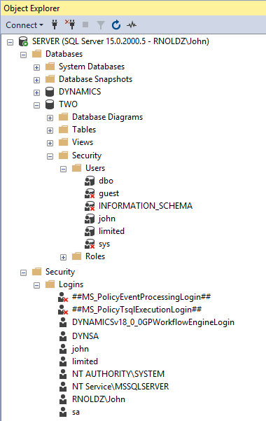
Security & Database Users
SSMS Object view
Shows database: SERVER
Shows user: RNOLDZ\John
Users in a Database
This example only shows GP users
Active Directory Groups are shown on future slides
Server -> Security -> Logins
Three types of logins:
SQL Logins (Maintained by GP)
Just a name – john, limited…
Active Directory Logins
Domain\User – RNOLDZ\John
Service accounts (Ignore now)
NT AUTHORITY and NT Service
Logins
Key that lets you into the Hotel/Server
Logins and Users
Key that lets you onto the Floor/Database (DYNAMICS or TWO)
Users
Key that lets you into the Room/Object (Table, View, SP…)

Slide 30
Setup Group in Active Directory
In Active Directory Users and Groups
Navigate to the correct Organizational Unit where Groups live
Right Click and select New -> Group
Enter Group Name and hit OK
Double Click the New Group
Click on the Members Tab
Add AD Users to this group
Do not make a Group a member of another Group because
it becomes very difficult to troubleshoot security issues.

Slide 31
Setup AD Group in SQL
In SQL Server Management Studio (SSMS)
Right click on Security/Logins and select New Login…
Click the Search button and then click the Object Types button
In Object types, check the Groups option and hit OK
Enter the start of the AD Group to be added
Click the Check Names (This helps to prevent spelling errors)
Click OK once the AD Group is found
From the User Mapping page, click the Databases
where the AD Group should have access
Click the Database role public and any other
required rpt_ role required

Slide 32
AD Groups – Whew!
For each Active Directory Group
Each group needs to be created in AD only once
Each group needs to be added to SQL only once
AD Group permissions can be added to any SQL object
Get in the habit of:
Create new a Stored Procedure
Give the Stored Procedure Permissions

Slide 34
Live Long and Prosper
Spock can now run the InvoicePostedSelect Report or the GP Excel Report

Slide 35
Suggested Resources
Rnoldz.com
Replicator
GP Macro Notepad++ XML file
Refreshable Report Template
Query String Finder
Notepad++ - link to text editor

Slide 36
Thank you for attending!
Questions???
John Arnold John_P_Arnold@hotmail.com

